Slide 1

Restro_Chatbot
Guided by Dr.S.Suthir Sir
Team 26

Slide 2
Team Members
 | Vivek Dharewa | 20BAI10032
 | Shivang Singh Negi | 20BAI10171
 | Ameya Shrikant | 20BAI10183
 | Tanay Singh | 20BAI10226

Slide 3


INDEX
1. Objective of the project
2. Modules in Restro
3. System Architecture Diagram
4. Restro’s GUI code
Implemenation and Demo
References

Slide 4

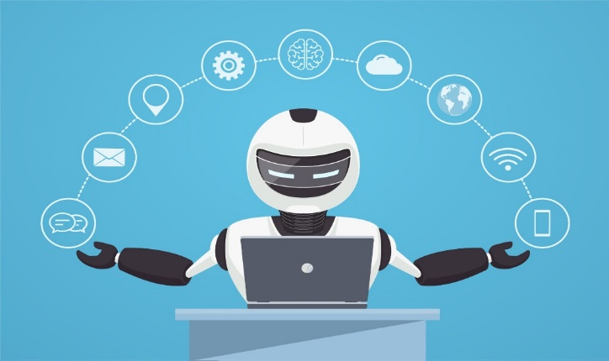
What’s the Objective?
To make a retrieval-based chatbot.
To implement it on a website.

Slide 5
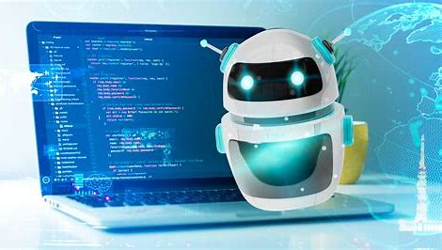
Modules in Restro
1.
Restro’s Code
2.
Restro’s GUI
3.
Restro’s implementation website

Slide 6
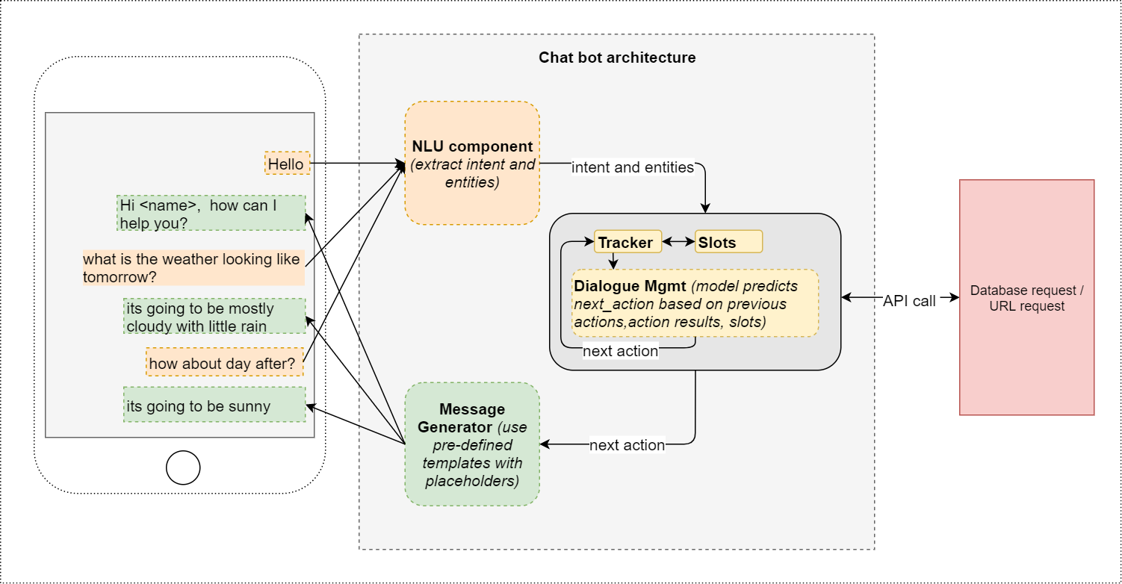
System Architecture Diagram

Slide 7

Restro Website

Slide 8
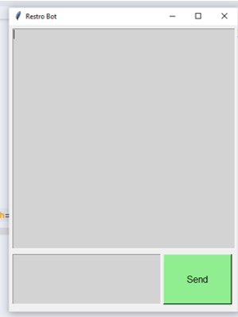
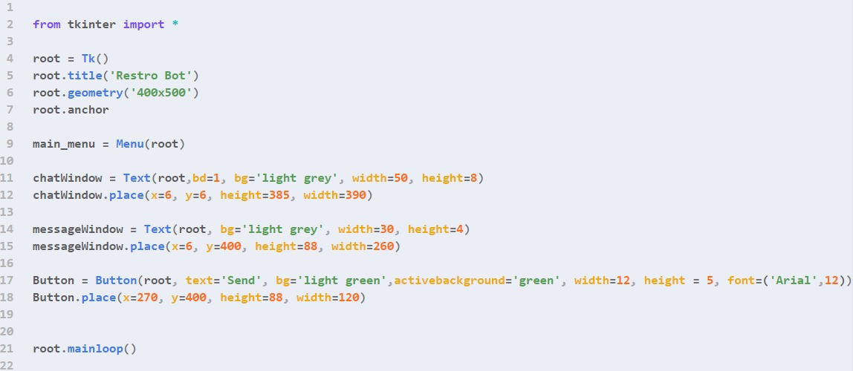
Restro GUI code

Slide 9
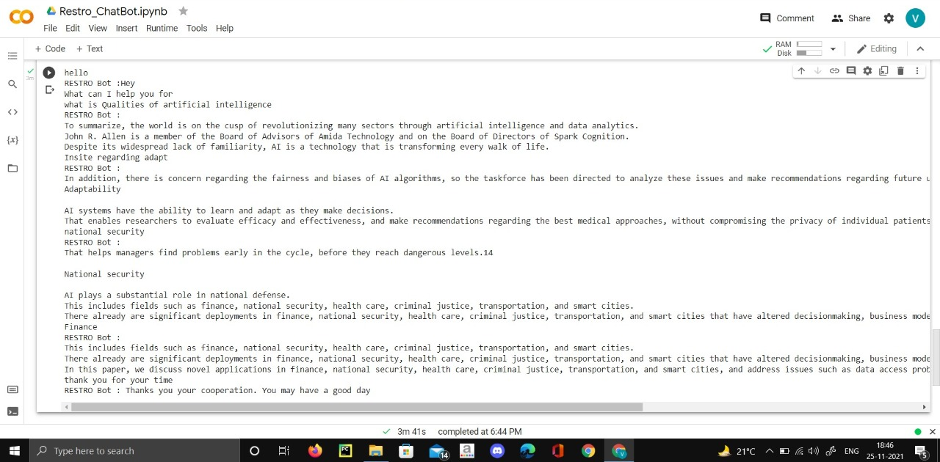
Implementation of Restro

Slide 10
References
Restro_ChatBot.ipynb - Colaboratory (google.com)
How artificial intelligence is transforming the world (brookings.edu)
Group 26 Python Chatbot (ssnegi23.github.io)

Slide 11
Thank You!!

